Slide 1
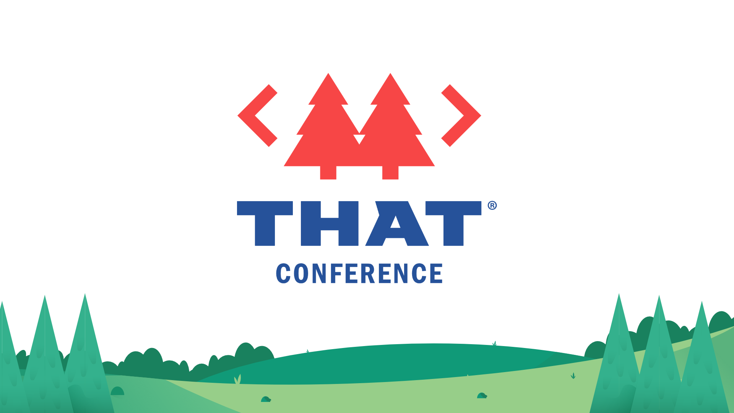

Slide 2
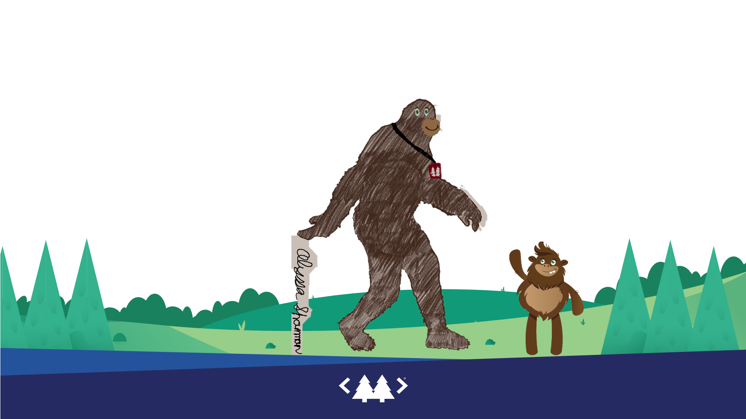

You
Scare me
You

Slide 3

bryan Shannon
Personal and Professional
Project Highlights
Iowa resident born and raised
Luckily Married 20+ years
Proud father of 2 daughters
15 Years in Customer Service
Became a BA in 2013
Became a Developer in 2018
Polyglot, but primarily C# and Salesforce
Purpose:
Tell a story
Neurodiversity advocacy
Challenge:
Articulation
Experience
Assistance: AI
Focus
Skill Complement
Collaboration

Slide 4


Slide 5


Slide 6
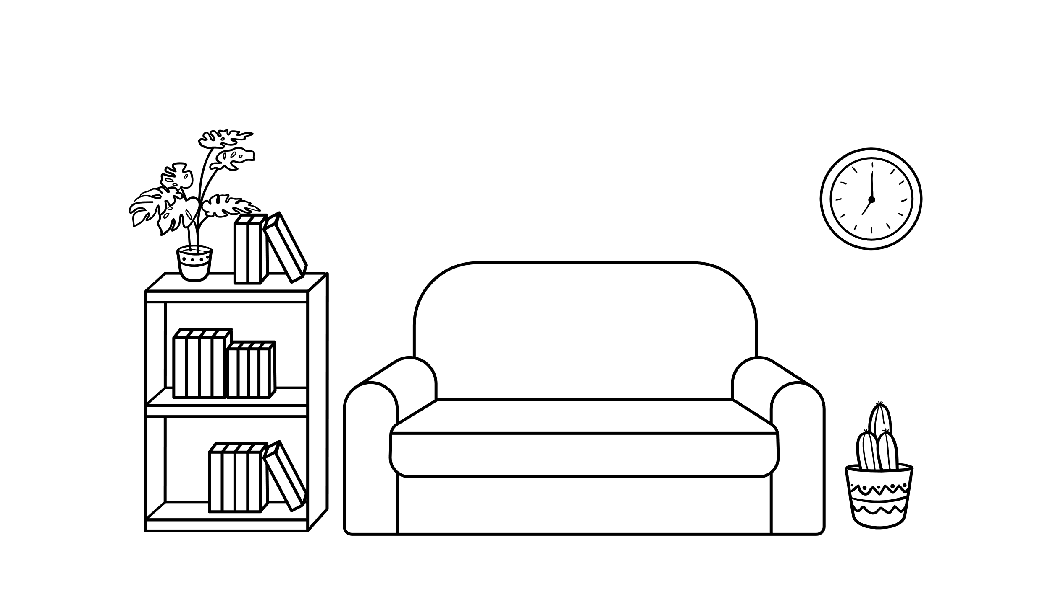




Client Scenario

Slide 7



Client Scenario
Client Scenario

Slide 8

Client Scenario

Slide 9

Client Scenario

Slide 10

Client Scenario

Slide 11


Client Scenario

Slide 12

Client Scenario

Slide 13

Client Scenario

Slide 14
Client Scenario

Slide 15

Client Scenario

Slide 16


Client Scenario

Slide 17


Metaphor Time
Metaphor Time

Slide 18
Metaphor Time

Slide 19
Metaphor Time

Slide 20
How can I expand this?

Slide 21
Get Perspective

Slide 22
Get Perspective
How can people “Get Perspective”

Slide 23

How can I write a book
I have a host of reasons not to do this
If you have ADHD you might understand some of these
If not, you might still get some of my hesitations about writing
ChatGPT is great at language, what if it can complement my skills
Write a
book
Storytelling transports us to teachable moments

Slide 24



Stories are naturally iterative

Slide 25



Stories are naturally iterative

Slide 26





Stories are naturally iterative

Slide 27
Basic terminology
Artificial Intelligence
Machine Learning
Intelligence Augmentation
Erin
Large Language Model
Generative
Pretrained
Transformer
Discord Bot
Build on ChatGPT
Discord thread = Memory
ChatGPT
AI/ML applied to language
Model based on a large set of language input
Effective at “predicting most likely next set of text”
Tool to Enhance our Intelligence

Slide 28
Inclusive story writing
Step
1 | Start with a Subject | Lifelike Scenario or Theme | Significant Event or Personal Journey | Divisive Issue | Any Subject that could have multiple points of view
2 | Who | Character Creation | 2 or more characters | 2 or more perspectives | Some characters may agree and you may have all characters start with different positions
2 | Who | Age, appearance | Personality | Strengths | Challenges
3 | Scenario | With characters defined | Prompt the AI to write a passage | You can just say Character A meets and talks to Character B and see what comes out | The more direction you give, the more you steer it towards your vision

Slide 29
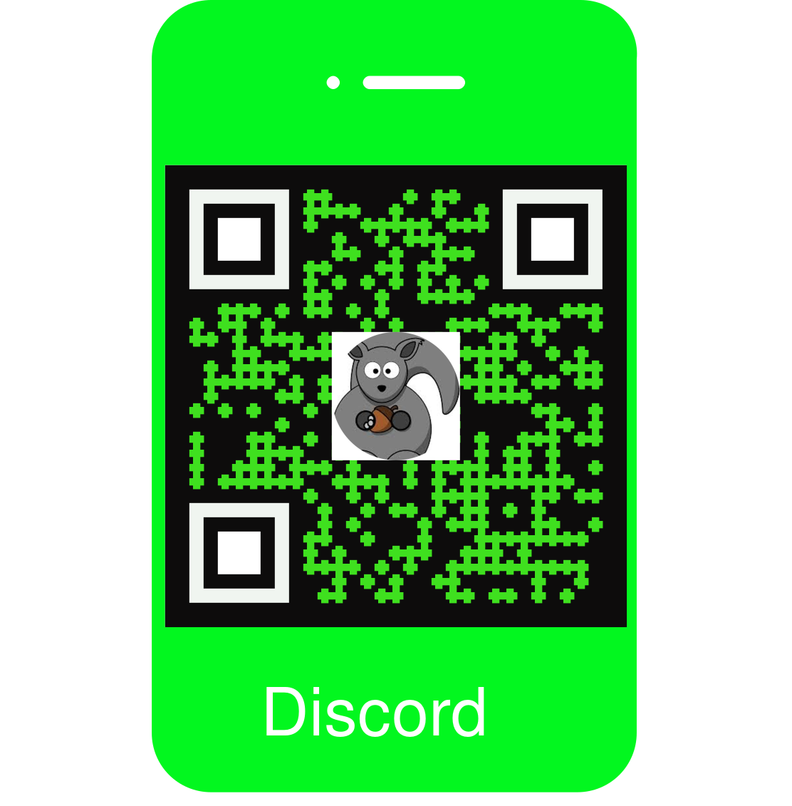
Let’s do <that>
DISCORD

Slide 30
Peaks and valleys
Pros
Cons
Tool to help, not replace, humans
Provides results from different thinking modes
Translate between concepts and long passages
Evolving to be able to connect to API’s and plug-ins to help with limited “knowledge”
Limited timeline of “knowledge”
Makes false statements with extreme confidence
Data driven bias
Enhances user’s existing bias
Large Language Models do not have “Knowledge”

Slide 31
Tools and takeaways
Takeaways
Tools
Be Curious
Embrace Intelligence Augmentation
AI cannot be ignored
Exploring diverse perspectives
Builds empathy
Brings us closer to the truth
X
Z
Translating ADHD
Discord Server for this chat
Meet Erin – Erin.ac
Site to learn about Erin the discord bot
GeneratedBy.com
Prompt Engineering tool
All About AI YouTube Channel

Slide 32
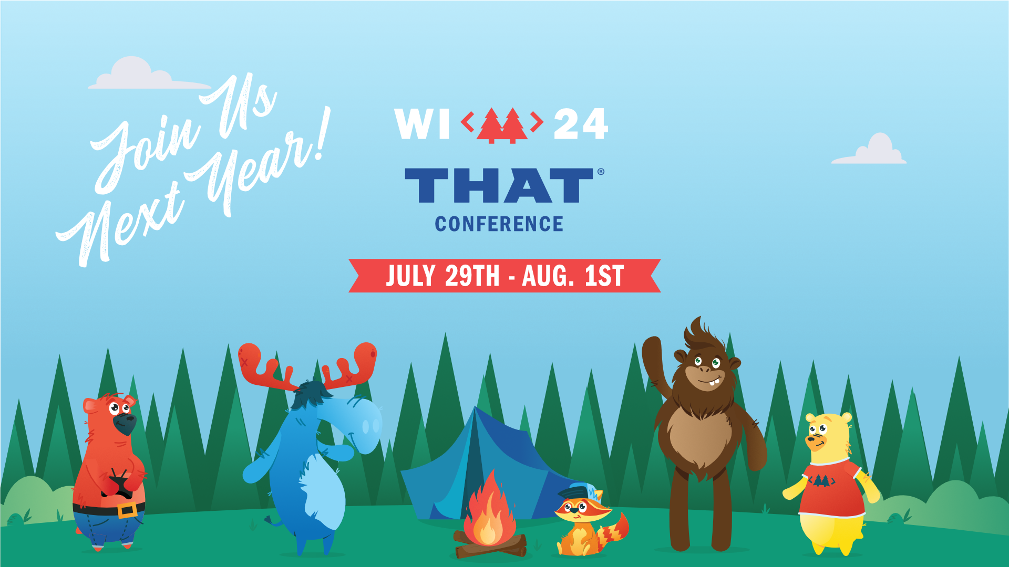

Slide 33
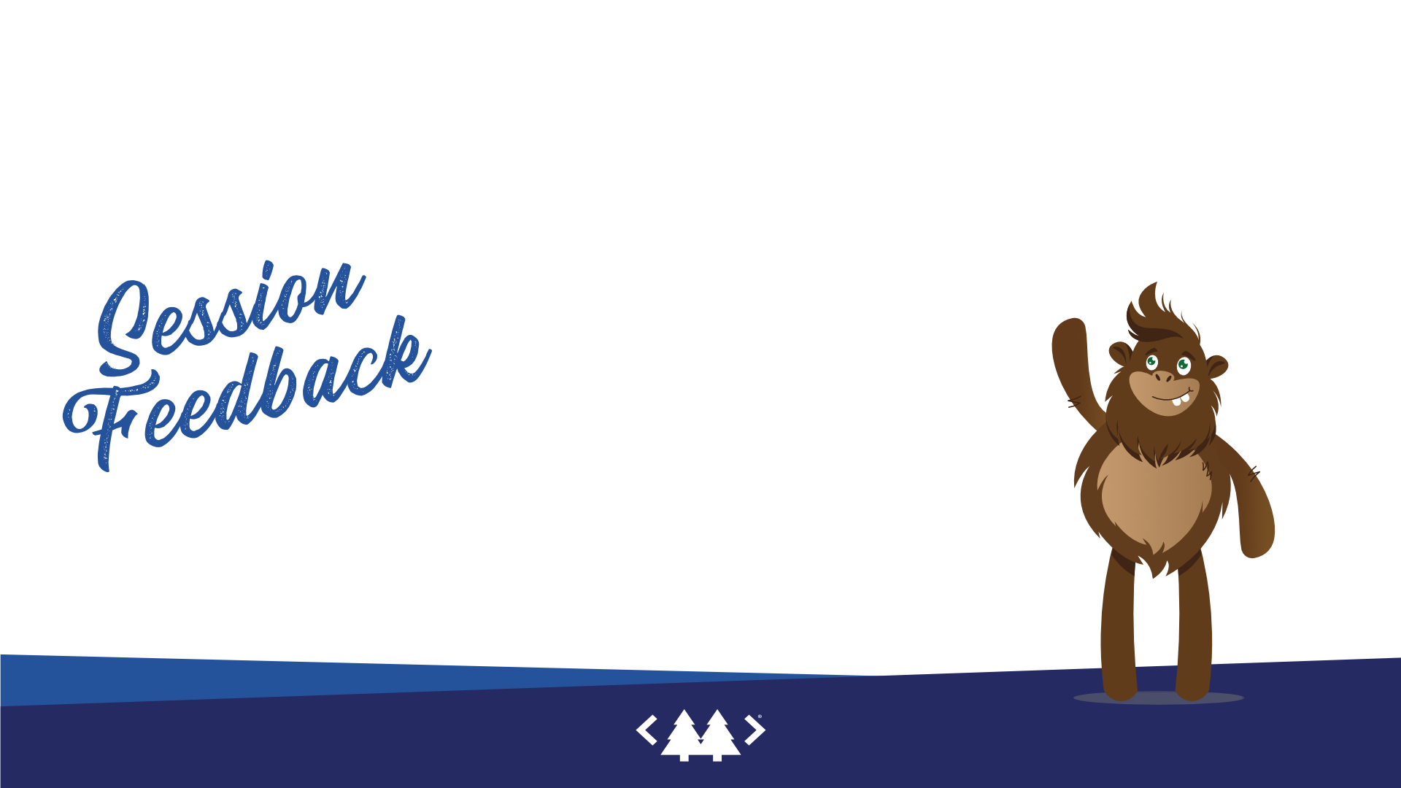
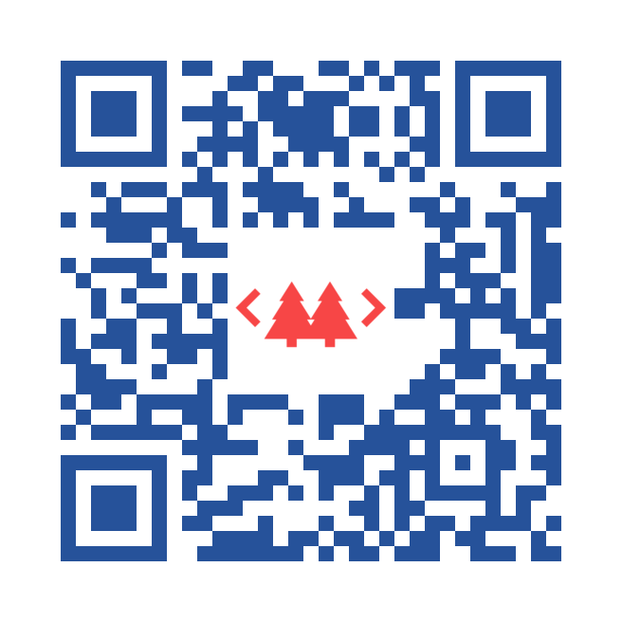



Slide 34
Notes:
Public speaking without barfing on your shoes @reverentGeek
People will look beyond flaws and encourage you to keep trying and give you the freedom to fail
People will forget what you said and did, but they will never forget how you made them feel.
If someone gets an inspiration like I get when I am first connected to an idea, it is worth it.
Entertainment
Authentic
Respect their time (deliver value)
Preparation for audience of goals
Learn secrets (not some youtube steal)
Fight Impasta with Experience
. Why? Problems/reasons/motivations
. What? Features/Highlights/Capabilities
. How?
. Blooper reel – paper balled up and thrown in the corner metaphor for Erin in multiple channels or ChatGPT in multiple chats
What would you do differently?
Where? Resource sharing
Are you not entertained? Visual story telling
Surprise – illus, brain candy
Drawn slide triggers memory of the intended content of slides, but stock photos and bullet points still lead to notes
Show and Tell by Dan Roam – book – or a video on YouTube
Practice – can’t be replaced
Plans to grow or shrink content
Record and replay to get feedback from my greatest critic
Get a Yoda

Slide 35
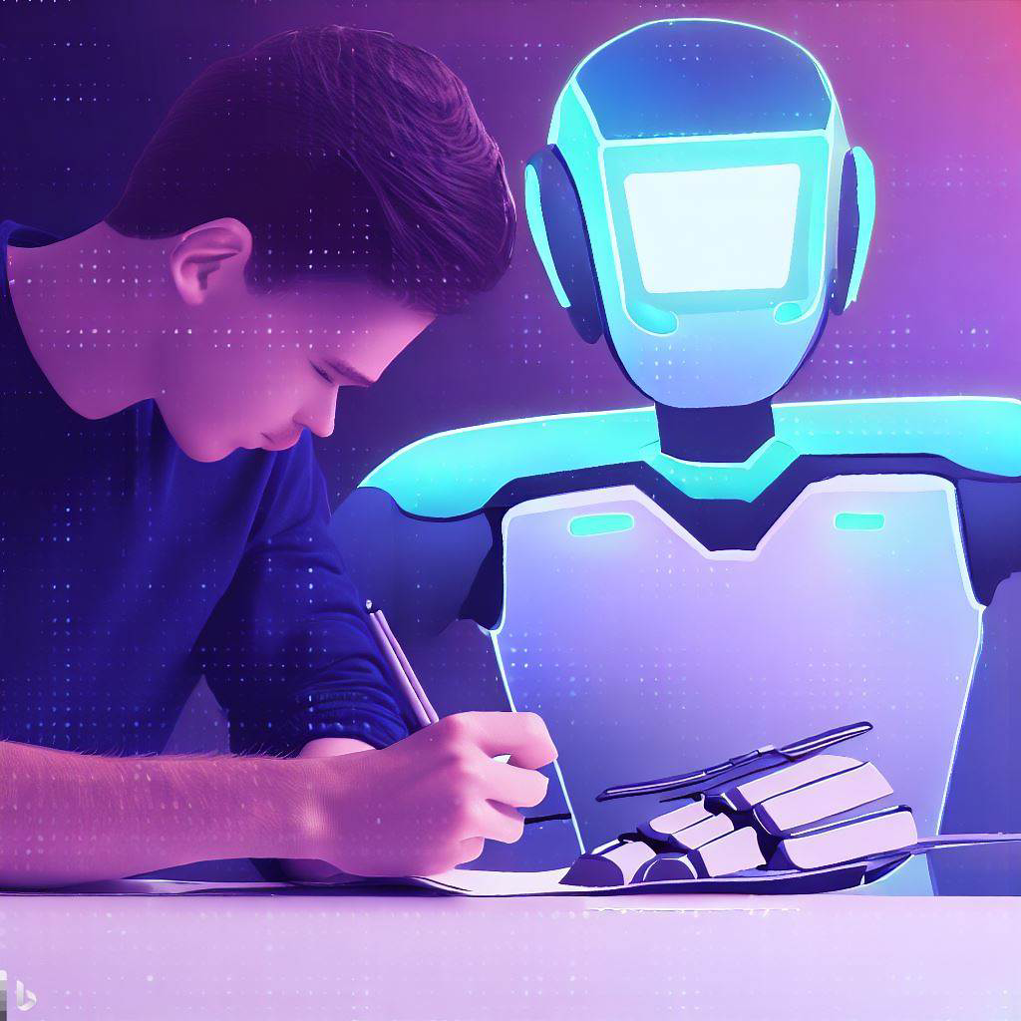
Enhancing Inclusion with Intelligence Augmentation
Building through Storytelling
Shifting Perspective helps us
Now I have a dilemma a big idea, with a lack of skill to execute the idea – So I decided to use ChatGPT technology
Basic Terminology
How to Collaborate with AI to Write a Story
Let’s Do THAT
Peaks and Valleys
Tools and Takeaways
Thank you and Feedback Please
This Photo by Unknown Author is licensed under CC BY-NC

Slide 36


Building through storytelling
Transport into Lived Experience
Images to add and animate
Joys
Sorrows
Challenges
I Never Thought of it That Way

Slide 37

How to collaborate with ai to write a story
Using Prompts and Iterations

Slide 38






















Peaks and valleys
Pros
Cons
Tool to help, not replace, humans
Provides results from different thinking modes
Translate between concepts and long passages
Evolving to be able to connect to API’s and plug-ins to help with limited “knowledge”
Limited timeline of “knowledge”
Makes false statements with extreme confidence
Data driven bias
Enhances user’s existing bias
Large Language Models do not have “Knowledge”

Slide 39
Peaks and valleys
Pros
Cons
Tool to help, not replace, humans
Provides results from different thinking modes
Translate between concepts and long passages
Evolving to be able to connect to API’s and plug-ins to help with limited “knowledge”
Limited timeline of “knowledge”
Makes false statements with extreme confidence
Data driven bias
Enhances user’s existing bias
Large Language Models do not have “Knowledge”

Slide 40
I am covering how I used AI to help me write a book that gives the perspective of the lived experience of both an ADHD and a non-adhd person that live together. This could be parent-child or spouses. There is the book and it’s purpose, and there is how I use AI to achieve that purpose. I want people to learn about AI via this somewhat unique use case, but I also want to inspire people to reevaluate their assumptions about other people. Through the power of storytelling, we have the ability to transport ourselves into the lives of others, experiencing their joys, sorrows, and challenges firsthand. By immersing ourselves in diverse narratives, we can broaden our understanding of the human condition and develop a deeper sense of empathy towards those whose experiences may differ from our own.
I still need to process how I’m going to close it out. And I’m still pretty unpolished.

Slide 41


Slide 42
++
I am covering how I used AI to help me write a book that gives the perspective of the lived experience of both an ADHD and a non-adhd person that live together. This could be parent-child or spouses. There is the book and it’s purpose, and there is how I use AI to achieve that purpose. I want people to learn about AI via this somewhat unique use case, but I also want to inspire people to reevaluate their assumptions about other people. Through the power of storytelling, we have the ability to transport ourselves into the lives of others, experiencing their joys, sorrows, and challenges firsthand. By immersing ourselves in diverse narratives, we can broaden our understanding of the human condition and develop a deeper sense of empathy towards those whose experiences may differ from our own.
I wanted to write a book, but I didn’t have the words to explain the concept. I didn’t have the experience in managing to keep a consistent writing style, or planning the various steps of creating a story, let alone a book. Even explaining the concept of the book has been consistently difficult for me to do. Therefore, using AI to complement my skills and allow me to focus on my idea.

Slide 43
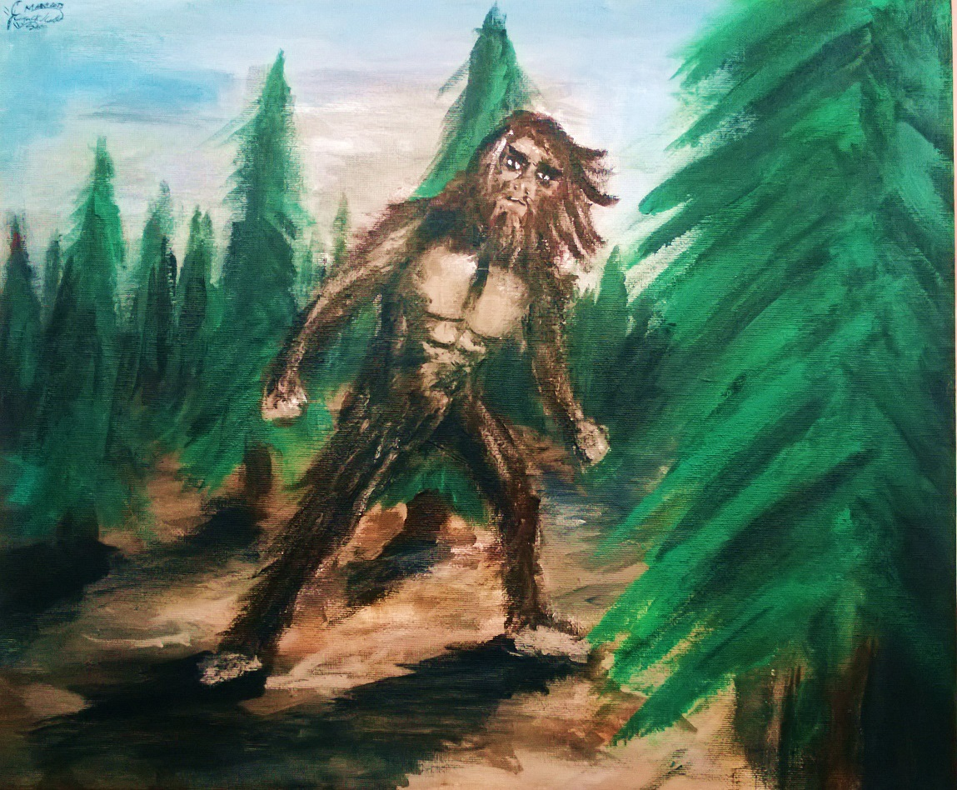
You
You
Scare
Me
Big
Small
This Photo by Unknown Author is licensed under CC BY-NC
Notes:
Hello You scare me. No Not somebody in here you scare me. Yes you the reader you You scare me. You represent the potential you have the potential a grasp what I have not been able to get anyone to grasp. You also have the potential potential to make me feel meaningless like everyone in here does. You scare me
you see my brain is wired differently, which is called neurodiversity. The nonlinear thinking seems like scattered thought, but it's really like two ideas are physically far apart in 3d space. And there is a wormhole connecting the two which most people can't see. I can come off as crazy by claiming that they are a shorter distance than they appear.
name is Brian
and I'm a business analyst turned developer
Well, now that I've got that off my chest allow me to dive deeper into my fear. It starts small, grows into something enormous and it's accompanied by everything in between. Is my fear scattered or is it organized? can you discern the difference? Or are you swayed by misconceptions, misconceptions? preconceived notions? Before he just might dismiss my thoughts completely, let me elaborate. The fear of small as of now he possess only a tiny fraction of information of my idea. It's enormous. The concept of grappling with what might be so colossal. It's inconceivable. And then there's everything in between, from our current starting point, to the profound concept embedded in my brain. There's a vast expanse that incites the fear am I going to be able to get you to understand from the small, tiny, undefined idea to the giant idea that's my brain. As a nonlinear thinker, my thoughts often transcend the confines of traditional thought. However, presenting these unconventional ideas to others can be challenging because most individuals operate within fixed boundaries. Though society claims to embrace outside of the box out of the box thinking many are incapable of grasping ideas that truly break away from the norm. It's the stasis space in between that truly scares me. The make or break aspect. If I can help you transition from the limited information presented thus far, to the abundant information, concepts and philosophies connected to my overarching idea, then we will have succeeded but if I'm unable to translate my nonlinear perception of the world in a way that resonates with you, our journey will falter. As we continue, let's embark on this intellectual voyage with open minds embracing both challenges and rewards that await us. That is, how Sophia the character of the main character of the book gets introduced. So you may be wondering or maybe you caught this in the
speech profile of what this book is about. And what this topic is about, so today, I'm going to be walking you through how I have used AI to write a book, or begin to write a book about the different perspectives involved when somebody with ADHD and somebody that doesn't have ADHD live together and what they're, and by understanding their different perspectives, hopefully, both sides so to speak can begin to can find it easier to have compassion and grace for each other with things that frustrate them, or that they find frustrating
I wanted to write a book, but I didn’t have the words to explain the concept. I didn’t have the experience in managing to keep a consistent writing style, or planning the various steps of creating a story, let alone a book. Even explaining the concept of the book has been consistently difficult for me to do. Therefore, using AI to complement my skills and allow me to focus on my idea.

Slide 44
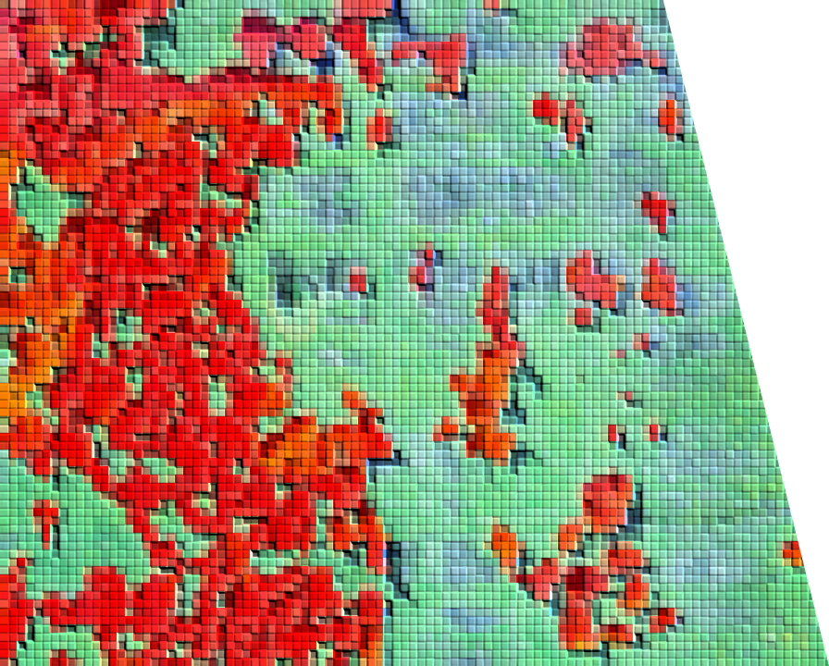
I never thought of it that way
Take a moment. Picture a time when you thought you understood something, and then someone, such as a child, questioned a fundamental part of what you thought you understood.
Now you think of that different angle every time it comes up.

Slide 45
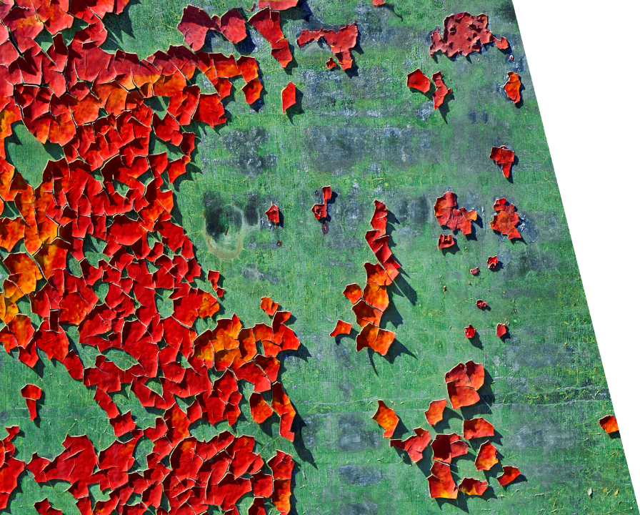
Small vs Big
ChatGPT technology helps
With communicating complex ideas
Notes:
Find Room – Turn off Notifications – check remote – Water? – Smile ☺
Warm up a room, find someone that you can talk to
Auto-pilot will kick in
. Hand problems
. Distracting pace
. Monotone
. Speaking pace
. Crutch words
. Werds
Virtual
. Anthropmorphize your camera
. Good lighting
. Audio is critical
. Lavalier? Mic? – lapel mic
. Stand
. Demo should reinforce the why
. Q&A tips
. Permit leaving
. Hallway/Open space track
. Link with slides that have links or other list of resources
. Celebrate
. We are people, who need people, even If you don’t like to be around people. When we learn how to “Get Someone’s Perspective” we become the people that people need – slide – credit David Neal

Slide 46
H1 only 1 is allowed
Better is
.heading—lg {font-size: 2 em;}
Understandable
UI mental models we build up on other sites carry to using our site, and failure to match
Userinyerface.com – takes a bunch of deceptive web patterns
Spans and divs are not navigable – onclicks either
Inputs w/ no labels – can do implicit labels though, which broadens clickable area, but not all assistive text recognize that
Implicit lable using htmlfor{id} makes the same effect
Tabindex=“0” is preferred unless you want to make it unnavigable then set it to -1
Alt=“company logo” prevents reading file name or svg parts
Alt=“” role=“presentation” or alt=“” aria-hidden=true – alt-text combined with one of the others is preferred because it is more robust

